Slide 1
Team-11 (Automated prediction of party name in rental agreements)
Participants: Sneha Sasanapuri
Abhishict Pamula
Amulya Ambati
Prasanna Poluru

Slide 2
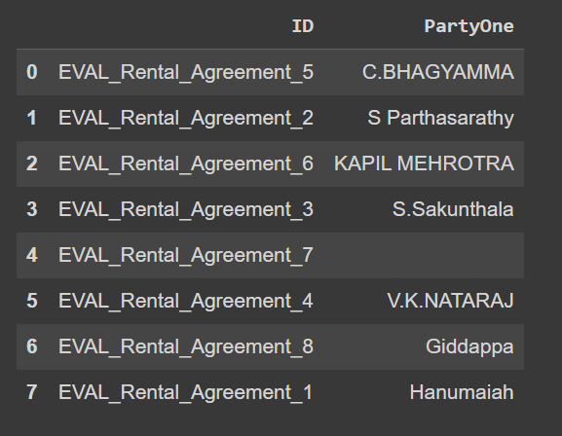
Accuracy Score
75%

Slide 3
Preliminary Observations
Identified pattern in data
Mostly occurring in first 2-3 paragraphs – Words of Interest
Derived regular expressions to extract specific sequence of words

Slide 4
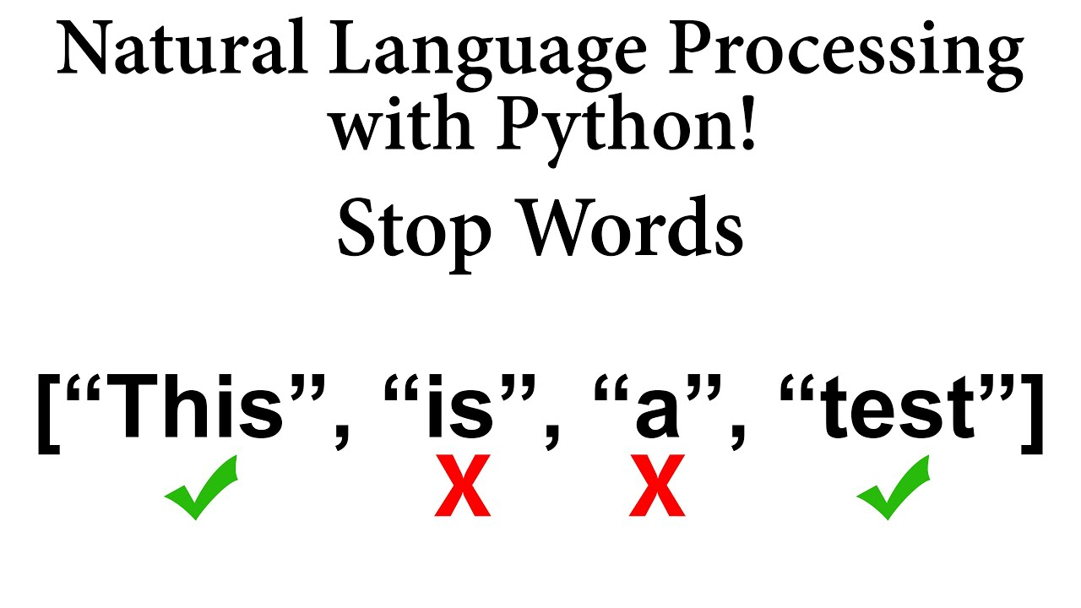
Text Preprocessing
Text in document is parsed using docx module and read as paragraphs.
Applied regular expression to detect and remove addresses and dates
Tokenized words

Slide 5
Feature Engineering
Extracted features from the text data that can help identifying tenant name
Features were including text patterns, context and doc structure

Slide 6

Approach
Rule based entity recognition
Spacy to get tokenized words
Defined a custom list of stop words
Filtered text is reconstructed back after this cleaning
Reconstructed text is passed to spacy module
Names identified through rule based entity recognition

Slide 7
Why did we choose this?
Helps in identifying and categorizing named entities in unstructured text data
Also, extract specific pieces of information from text, such as names of people, organizations, locations, dates, etc
Can identify links between named entities and their relationships

Slide 8
How it works?
Extracting text from doc
Preprocessing the text
Filtering the text

